Slide 1


Slide 2
Welcome

Slide 3






Database Management System of NETFLIX
Introduction
Objective
System design
Database system architecture
Implementation
Conclusion

Slide 4










4
INTRODUCTION
97% for you
16+
2022
NETFLIX is the world’s leading internet TV network, with more than 100 million members worldwide enjoying 125 million hours of TV shows and movies each day, including original series, documentaries, and feature films.
Skip

Slide 5

Objective
97% for you
2022
16+
To develop a platform that gives our users control over what they want to watch whatever their taste, no matter where they live, we give you access to the best TV series, documentaries and feature films, in one simple subscription.
Play

Slide 6
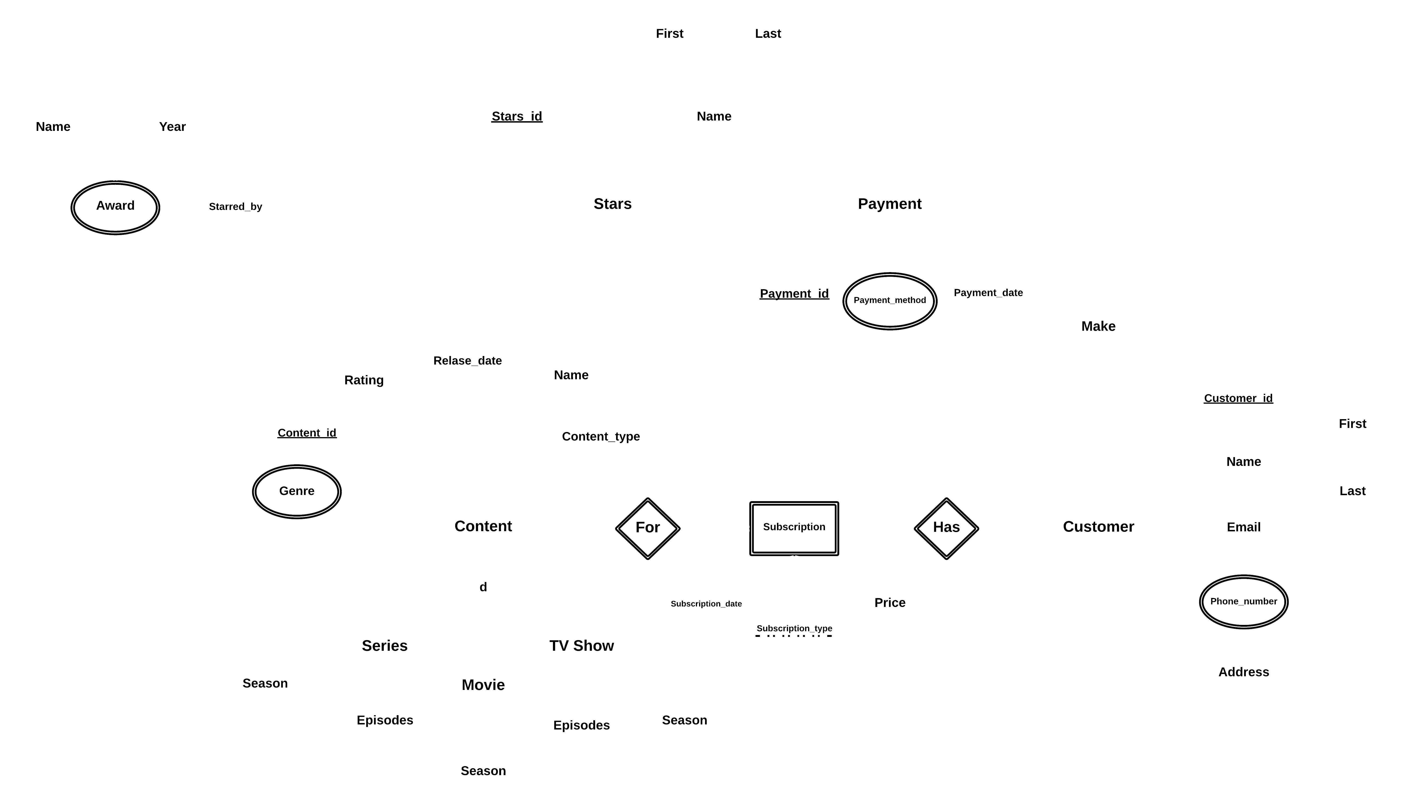
netflix
4
Enhanced Entity-Relationship
System design
97% for you
16+
2022
Skip

Slide 7
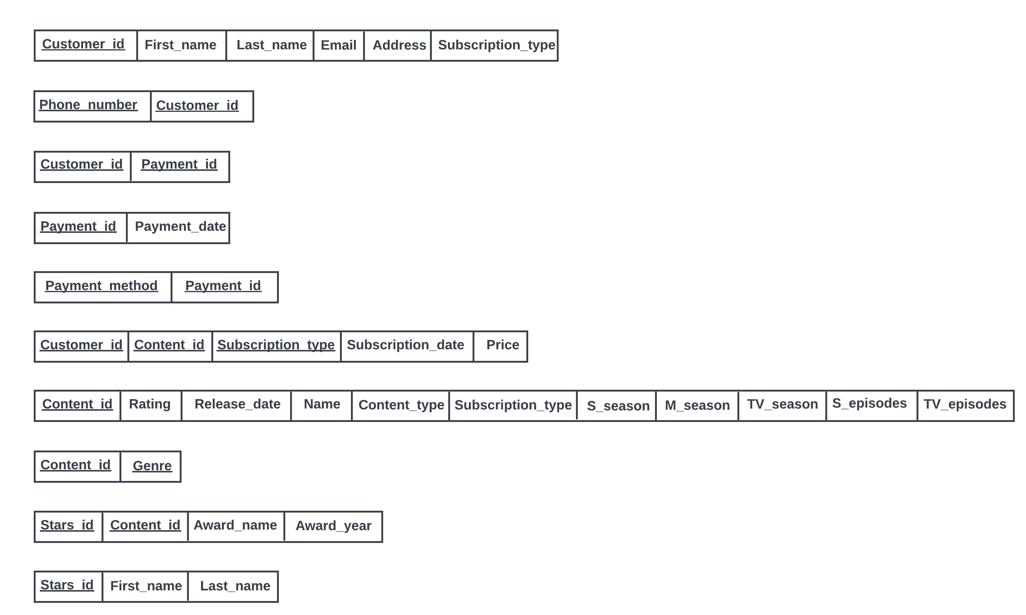
Netflix
4
Schema
System design
97% for you
2022
16+
Skip

Slide 8
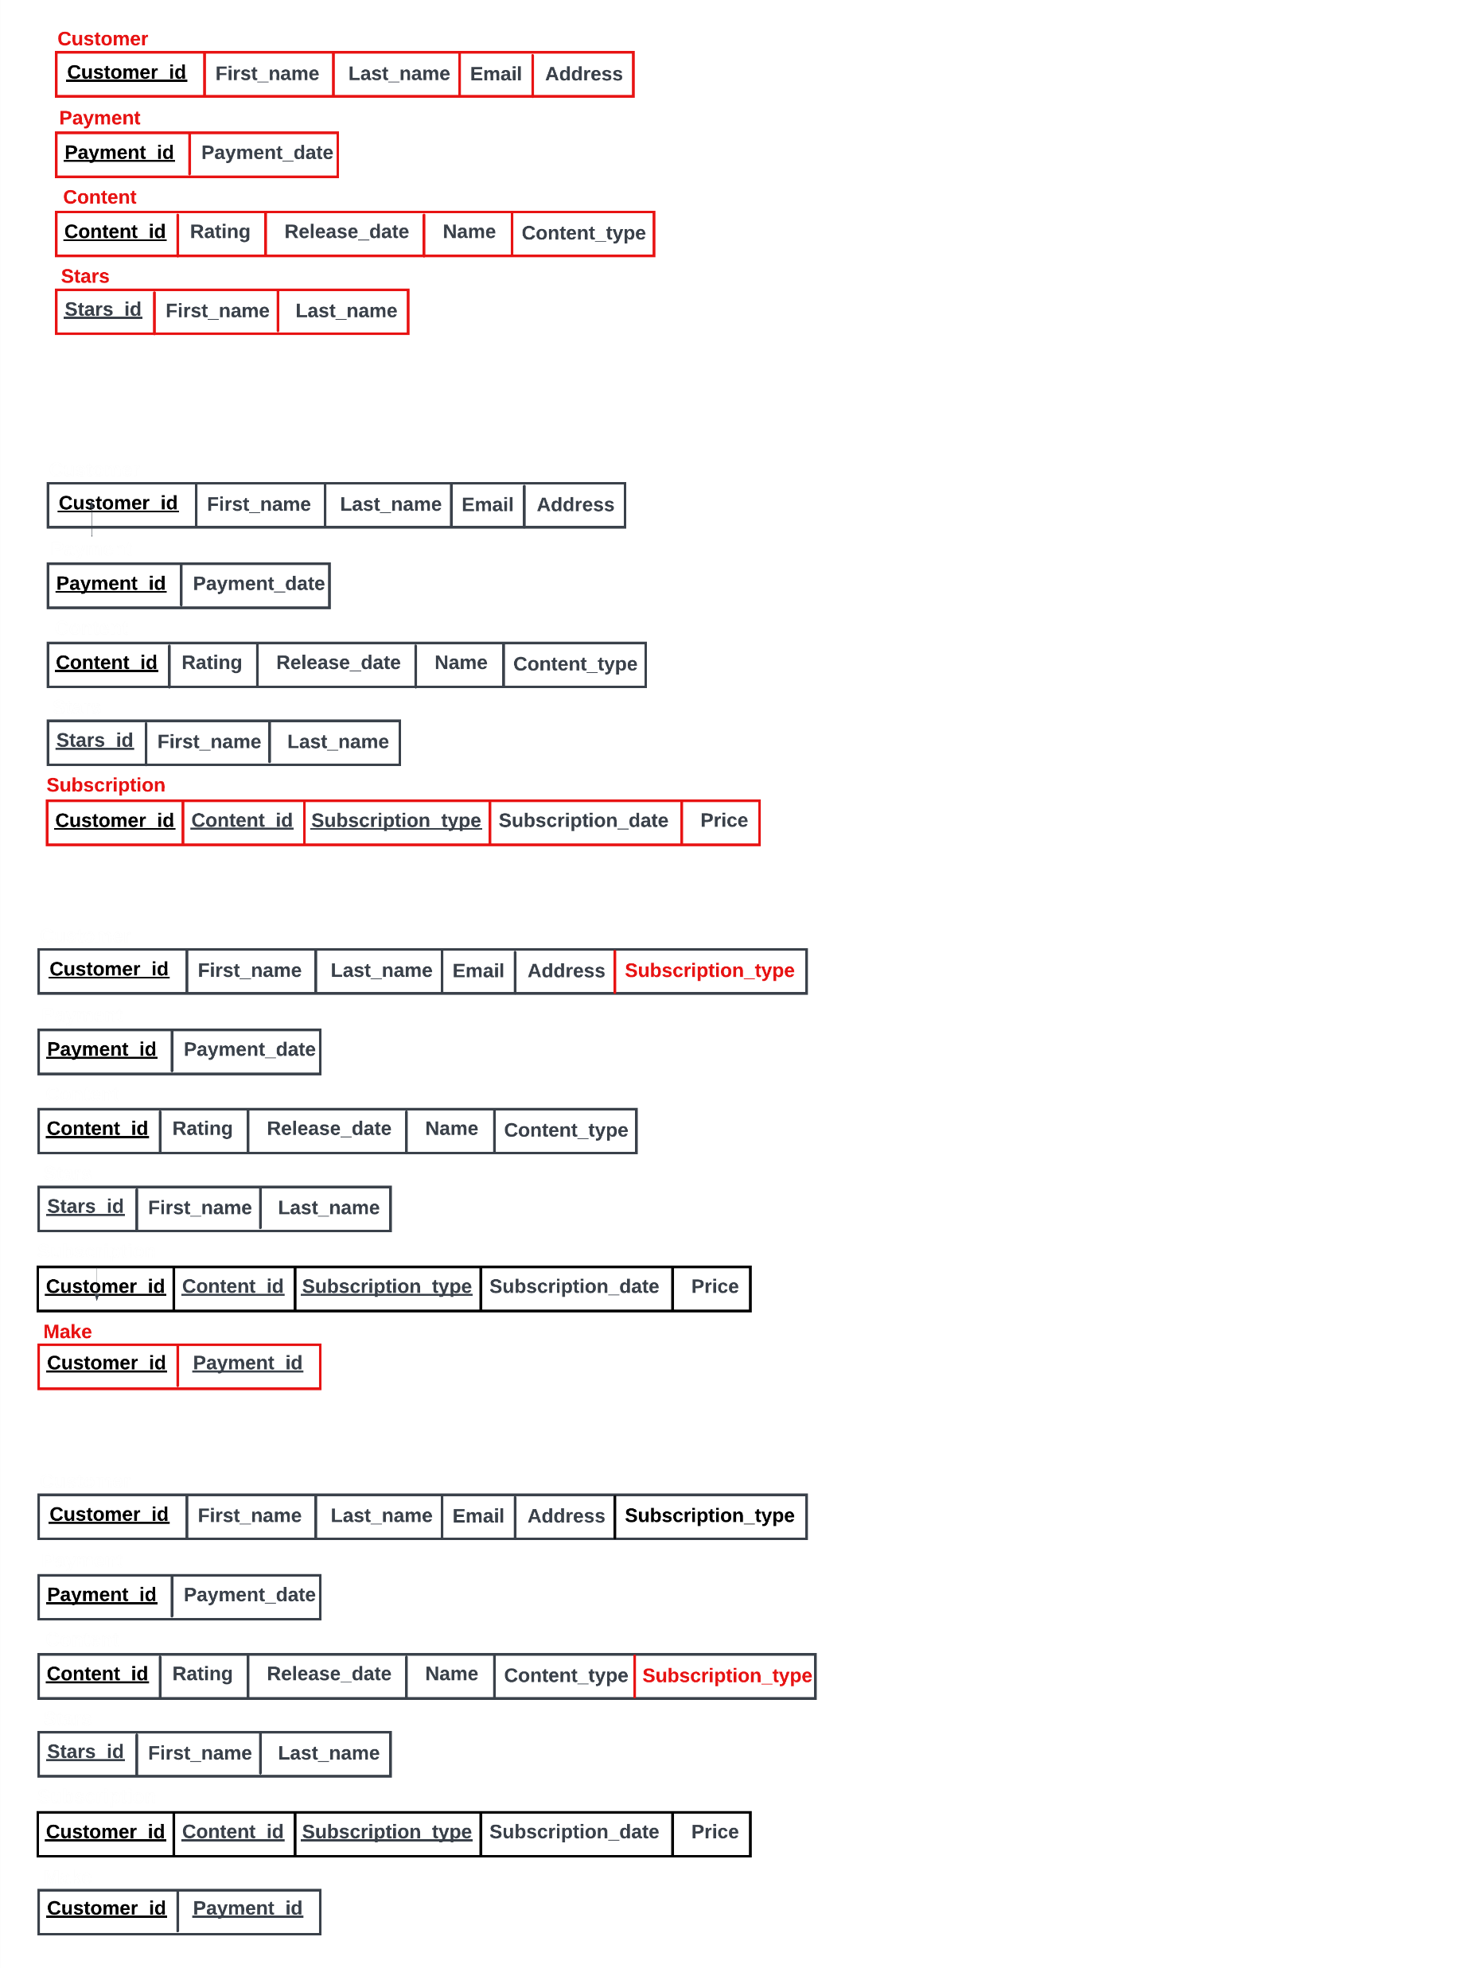
Schema
Netflix
4
System design
97% for you
16+
2022
1.
Mapping of Regular Entity
Skip

Slide 9
Schema
Netflix
4
System design
97% for you
16+
2022
2.
Mapping of Weak Entity
Skip

Slide 10
Schema
Netflix
4
System design
97% for you
16+
2022
3.
Mapping of Binary 1:1 Relation
Skip

Slide 11
Schema
Netflix
4
System design
97% for you
16+
2022
4.
Mapping of Binary 1:N Relationship
Skip

Slide 12
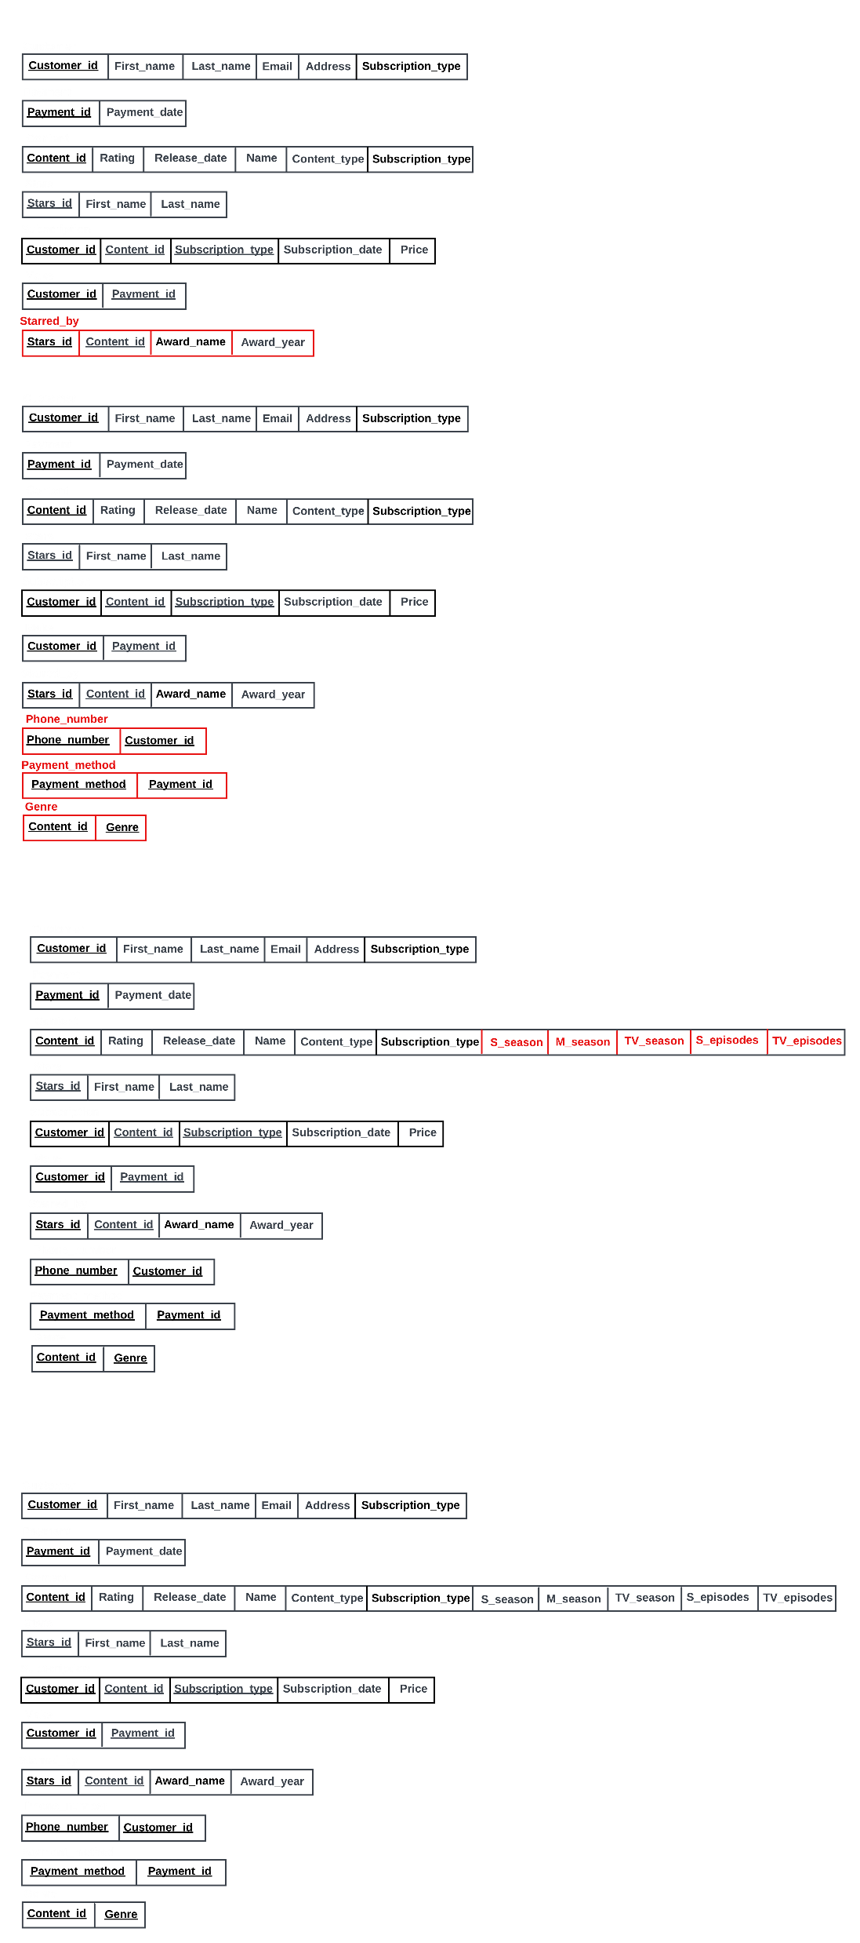
Schema
Netflix
4
System design
97% for you
2022
16+
5.
Mapping of Binary M:N Relationship
Skip

Slide 13
Schema
Netflix
4
System design
97% for you
2022
16+
6.
Mapping of
Multivalued
Attributes
Skip

Slide 14
Schema
Netflix
4
System design
97% for you
2022
16+
7.
Mapping
Specialization
Skip

Slide 15

4
Database system architecture
System architecture type
97% for you
2022
16+
NETFLIX uses a distributed DBMS so that data can be stored locally in locations with the highest demand. This improves access time. Additionally, when accessing data which is what happens when you select a movie on Netflix, the query can be processed in multiple database locations, taking advantage of the parallel CPU processing power available in a DDBMS. This reduces hardware demands and improves efficiency.
Play
See More

Slide 16
4
Database system architecture
System network type
97% for you
2022
16+
The network type used in designing NETFLIX is a mesh network which is a network in which devices or nodes are linked together, branching off other devices or nodes. These networks are set up to efficiently route data between devices and clients. They help organizations provide a consistent connection throughout a physical space.
Play
See More

Slide 17
4
Implementation
97% for you
2023
16+
1 2 3 4
ER – Diagram
Index
On delete/update
cascade
Trigger
netflix

Slide 18

4
netflix
Make fun with us
Conclusion
97% for you
16+
2022
This project implements a streaming service that offers a wide variety of award-winning TV shows, movies, anime, documentaries, and more on thousands of internet-connected devices. You can watch as much as you want, whenever you want – all for one low monthly price. It can be said with full assurance that if the system is fully implemented, all the advantages of this platform will be desired by all segments of society!
Play
+

Slide 19
thanks

